Slide 1
L10 Common Emergencies
Resus Drill

Slide 2
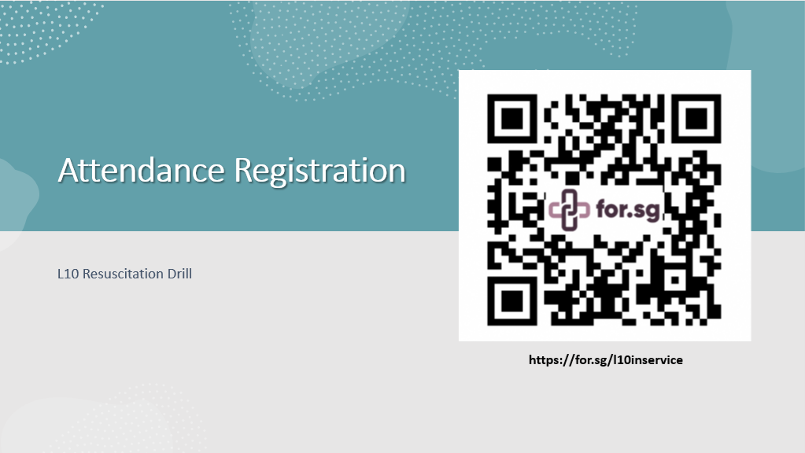
Case Scenario 1

Slide 3
Case Scenario 1

Slide 4
Case Scenario 1
Ms Lim, 80 years old, Female Chinese, is admitted from ED around 2pm for GE and giddiness for investigation. Not clerked by team doctors yet.
Upon arrival, she became restless and confused. She also appears diaphoretic ++.
Chief complains –
  diarrhoea 5x since yesterday, vomiting 2x undigested food
  Giddy x 1day
  No fever
  Vitals in ED (10am) – BP 100/65mmhg, HR 110/min, RR 25/min, Sp02 95% RA
  HC taken in ED – 4.0
  GCS 14, E4V4M6

Slide 5
Case Scenario 1
PMH - DM Type 2, Dementia, Hypertension, Left CVA since 2018
Medication
  - SC Actrapid 4 units tds (premeal)
  - Atenolol 100mg om
  - Plavix 75mg om
  - NKDA

Slide 6
Case Scenario 1
You are the SN on duty
Her daughter (main carer) called you to attend to the patient.
Upon questioning, daughter said pt. only had milk for breakfast (injected SC Actrapid 4u prior to breakfast) but still vomited with diarrhoea 1x before decided to bring her to the hospital
She have not taken lunch as she has been waiting in the ED since 10am.
Patient is on IV D/Saline upon arrival from ED, however IV Cannula site is leaking
Please attend to the patient (shoutout the nursing plans/management)

Slide 7
Case Scenario 1 – Recheck HC
Bedside HC – 3.0
Patient alert but confused ++, restless and agitated

Slide 8
Case Scenario 1 - Meds Order
Glucose 15g Oral Powder stat

Slide 9
Case Scenario 2

Slide 10
Case Scenario 2
Mr Lee, 58 yrs old, Male Chinese, DOA – 1 day ago
Diagnosis: TIA, on PAF monitoring
PMH – IHD with CABG done 2017 and COPD (15yrs)
Social Hx - Ex-smoker (stopped 2yrs ago)
Medication –
  S/L GTN 1 tab prn
  Aspirin 100mg om
  Bisoprolol 10mg om
  Amlodipine 10mg om
  Prednisolone 30mg om
NKDA
Patient is planned for 2D echo appointment this pm.

Slide 11
Case Scenario 2
Appears lethargic looking and pale
Complain chest discomfort
Parameters taken prior to transportation
  BP: 101/70mmHg
  PR: 130 b/min
  RR: 34 b/min
  SpO2: 89% on room air
  GCS: E4V5M6

Slide 12
Case Scenario 2
You are the SN in charge of patient
Please attend to the patient

Slide 13
Case Scenario 2 - Meds Order
S/L GTN 1 tab prn
Salbutamol : Ipratropium Br : Sodium Chloride stat
  Salbutamol 0.5% Neb Solution 1mL
  + Ipratropium Br 0.5mg/2mL Nebule 2mL
  + Sodium Chloride 0.9% Inj 1mL

Slide 14
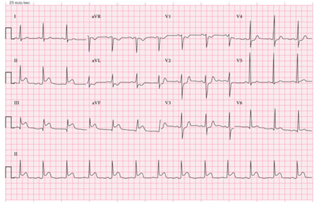
Case Scenario 2 - ECG

